Slide 1


CAPSTONE
PRESENTATION
EXTRACTION OF KEYWORDS AND SUMMARIZATION OF THE CHAIRMAN'S SPEECH ON ANNUAL REPORTS

Slide 2

Business Objectives
Business Problem
01
Provide investors with a tool that streamlines the investment decision-making process, improving efficiency and aiding in the pursuit of high-return, lower-risk investments
Solution
02
03
Benefits
Key features
04

Slide 3


DATA COLLECTION
  Data is of secondary source and is taken from Prowess Database.
  It is a comprehensive and reliable database focused on Indian companies and industries.
  It contains financial and non-financial data, including annual reports, stock market information, and more.
  With access to 414 chairman speeches, we have used 105 chairman speeches for our analysis.

Slide 4

KEYWORD EXTRACTION
  We used the Inception annotation software to extract key terms and phrases from these speeches.
  Keywords extracted in the form of IOB (Inside, Outside, Beginning) tags
  The software generated the output in CONLL format, presenting the extracted keywords in the format of "word _ tag."

Slide 5
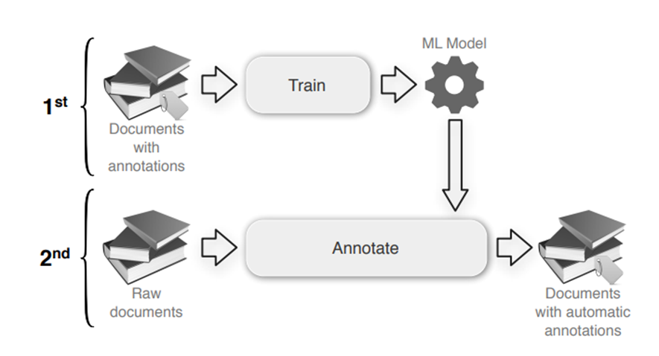
MODELING
NAMED ENTITY RECOGNITION
Working of NER model
  Text Preprocessing
  Entity Identification
  Entity Classification
  Contextual Analysis

Slide 6
MODELING
RoBERTa
  It builds on BERT and modifies key hyperparameters, removing the next-sentence pretraining objective and training with much larger mini-batches and learning rates.
  RoBERTa has the same architecture as BERT, but uses a byte-level BPE as a tokenizer (same as GPT-2) and uses a different pretraining scheme.

Slide 7
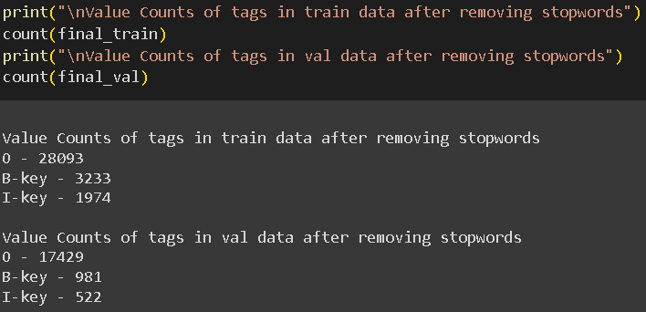
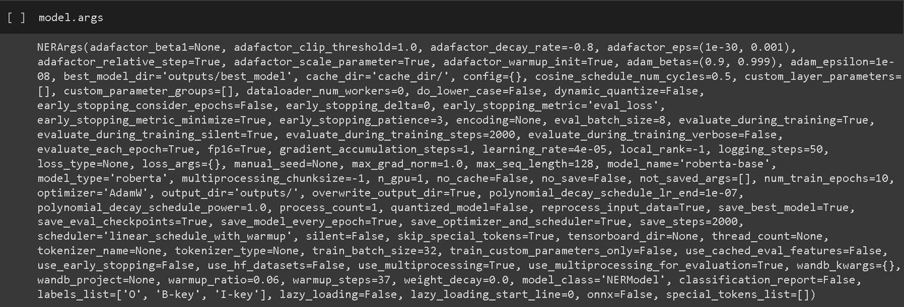
MODELING AND CHALLENGES FACED
  High imbalance of tags.
  Initially, got an F1 score of zero.
  Difficult to tune the hyperparameters.
  Model overfit with 90% F1 score on training data and 39% on validation data.
  RoBERTa has a limited vocabulary size of 30,000. unknown words are marked as UKN and tag is then predicted as “O”.

Slide 8
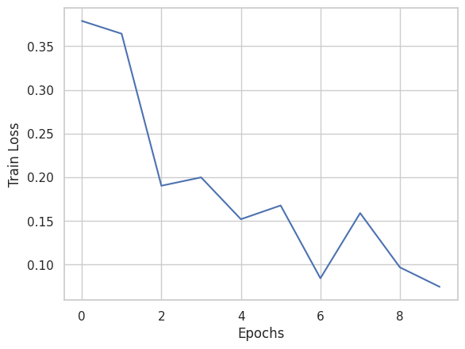
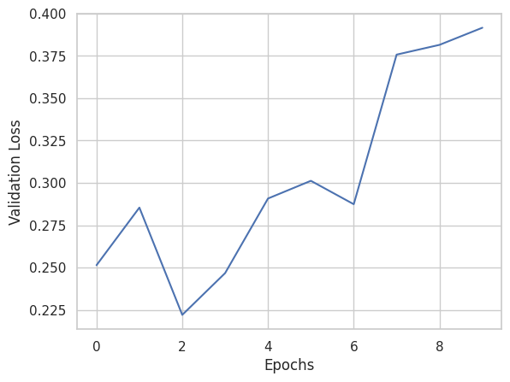
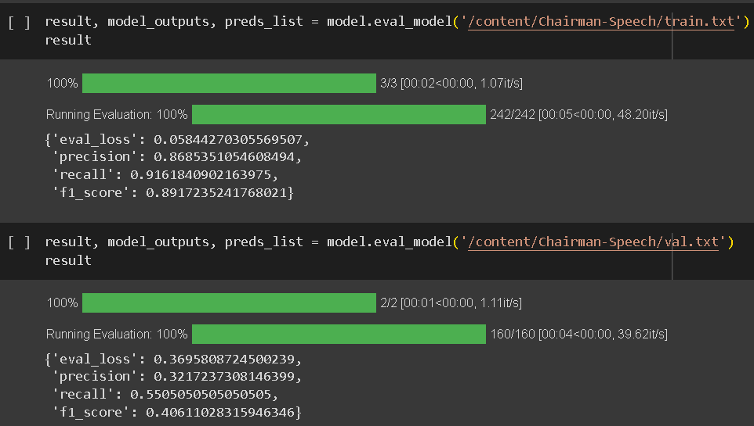
MODELING AND CHALLENGES FACED
  Train loss has continuously decreased with each epoch while validation loss has increased - which is a clear sign of overfitting.

Slide 9
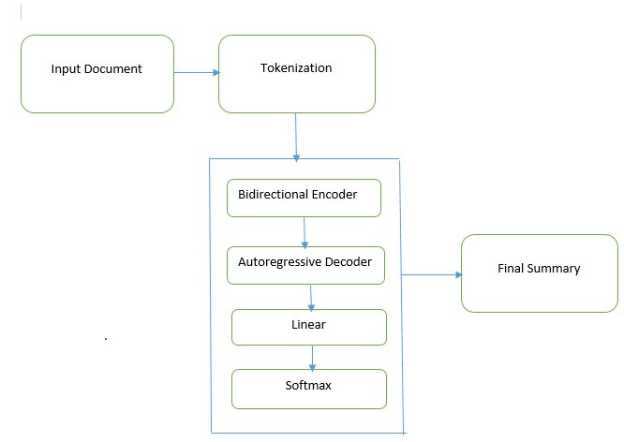
SUMMARIZATION
  BART is a transformer encoder-encoder (seq2seq) model with a bidirectional (BERT-like) encoder and an autoregressive (GPT-like) decoder.
  It's trained in two steps: first, it learns by messing up text and trying to fix it (like a puzzle), and then it learns to create new text based on the original text.

Slide 10
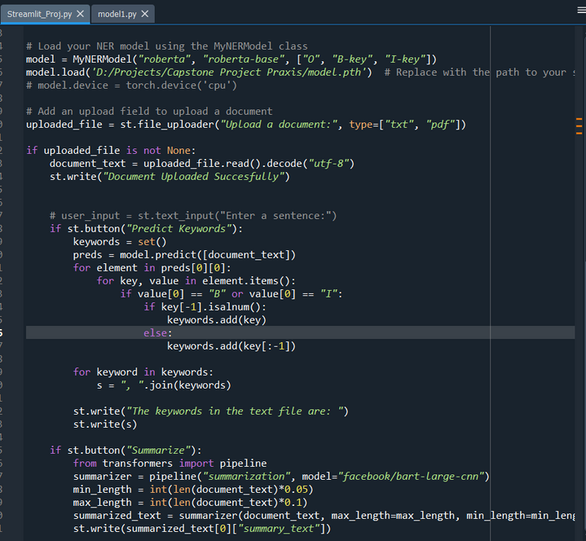
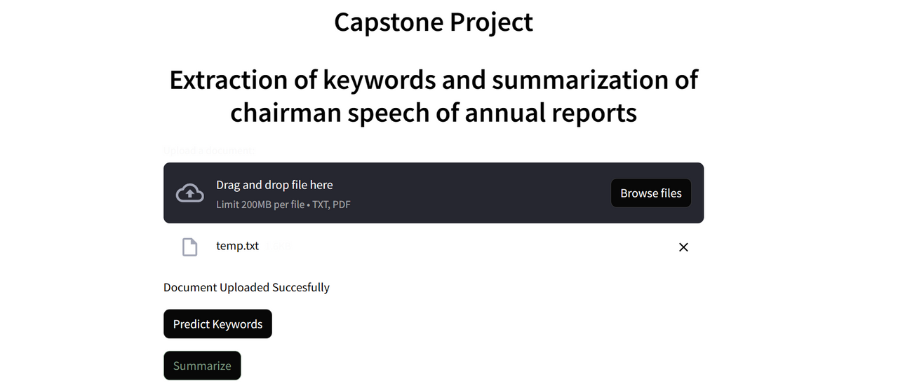
Model Deployment
  1. User Interface: A user interface has been developed using Streamlit, This interface serves as the front-end for users to interact with the model.
  2. Input Source : Users access the Streamlit interface to provide text documents containing chairman speeches.
  3. Data Transmission: Once the user submits the document, the content of the selected document is transmitted to .
  5. Model Processing: The loaded content is then processed by the deployed model.

Slide 11
Conclusion
  This project has highlighted the importance of the Chairman's speeches as a window into the vision, goals, and communication strategies of companies.
  The extracted keywords and summarized content offer a comprehensive understanding of the messages conveyed in these annual reports.
  Such insights are invaluable for investors, stakeholders, and anyone interested in corporate governance and communication practices.
  This helps with informed decision-making, benchmarking, and a deeper understanding of the priorities and trends across different sectors.

Slide 12
FUTURE
SCOPE
  In the future, we plan to integrate test data into our training dataset for manual refinements, embracing a semi-supervised machine learning approach.
  This method can be extended to speeches from various corporate leaders, including directors, CEOs, and CFOs.
  We're also looking to incorporate sentiment analysis, providing deeper insights into Chairman's speeches by assessing their emotional tone and sentiment.

Slide 13



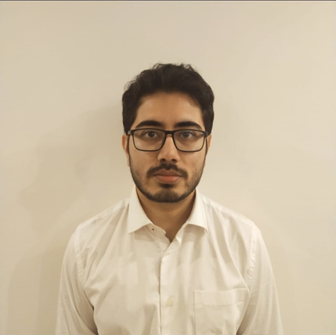
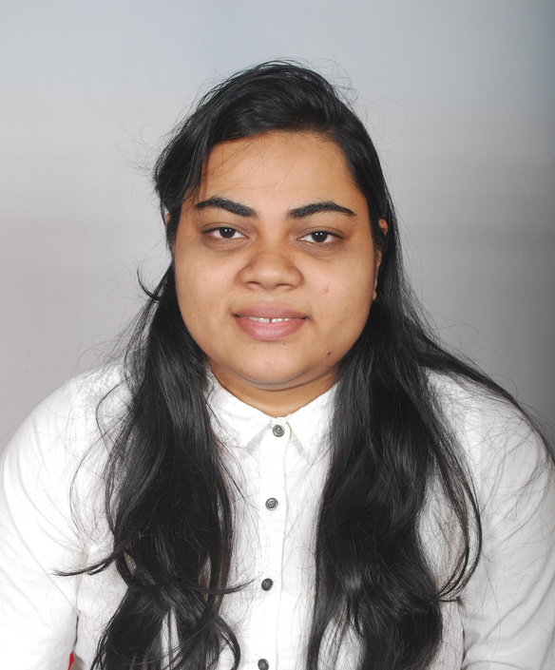
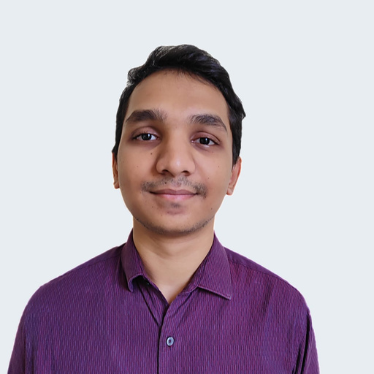
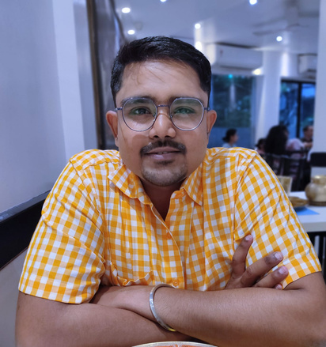
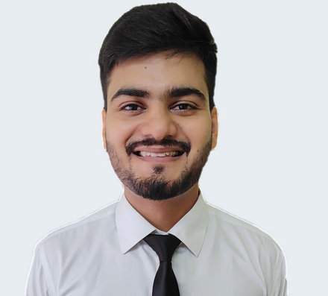


Our Team
Ayan Roy
Krishna Pradhann
Prem Sambhaji Jadhav
Soumyojit Basu
Tarun Yadav
C23009
C23016
C23021
C23037
C23032

Slide 14

THANK YOU

